Slide 1

AUTOMOTIVE SOFTWARE COMPANY
Nextis Mobile WMS
Warehouse Management System for Nextis ERP

Slide 2

Main features
Keeping track of positions of items with or without quantity
Paperless Receiving, Picking and Inventory Counting
Item Overview module
Receiving multiple documents all at once
From simple Discrete order picking to complex Batch-Wave-Zone picking defined by a diagram
Two-phase Full Inventory Counting & Cycle Counting

Slide 3
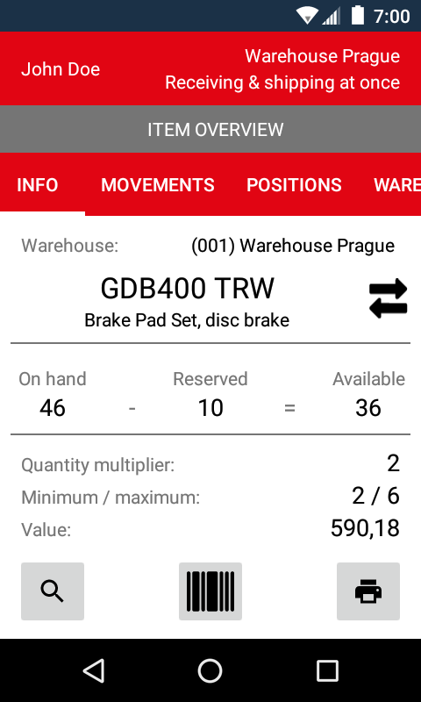
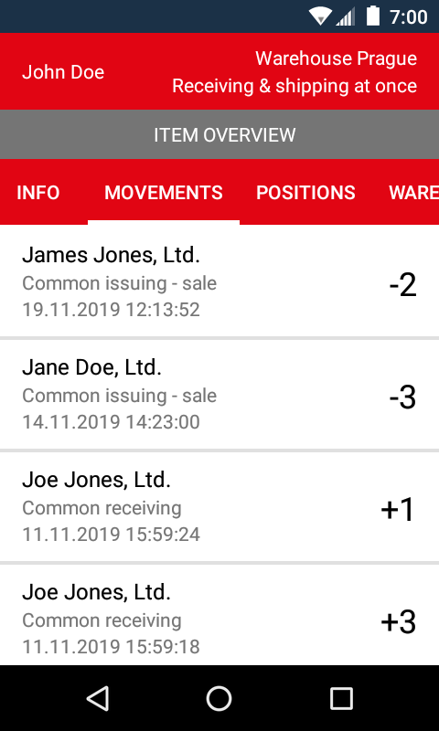
Item Overveiw Module
All item information in one place
Code, Brand, Full name
On Hand, Reserved and Available quantity
Min / Max quantity
Stock card, i.e. list of stock movements
List of positions of the item with quantity
List of quantities at the other warehouses

Slide 4
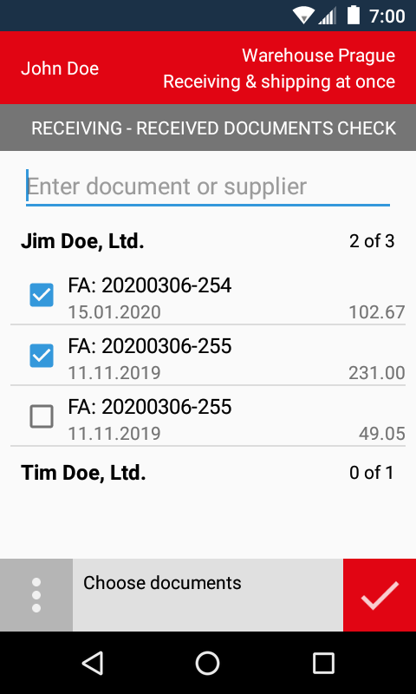
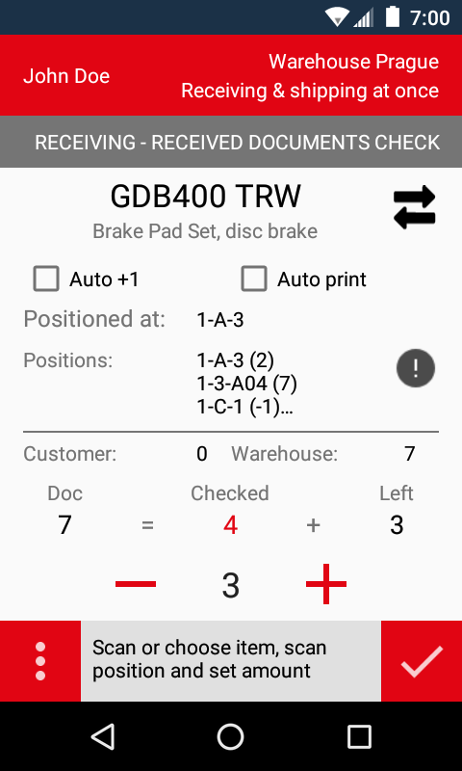
Receiving
Receiving goods from suppliers or your other warehouses
Paperless receiving
Receiving multiple invoices/delivery notes at once
Simple assigning new unassigned barcodes to received items
List of unreceived items
Printing labels for all goods or just for those, which has not been received yet
Receiving and positioning goods at the same time

Slide 5
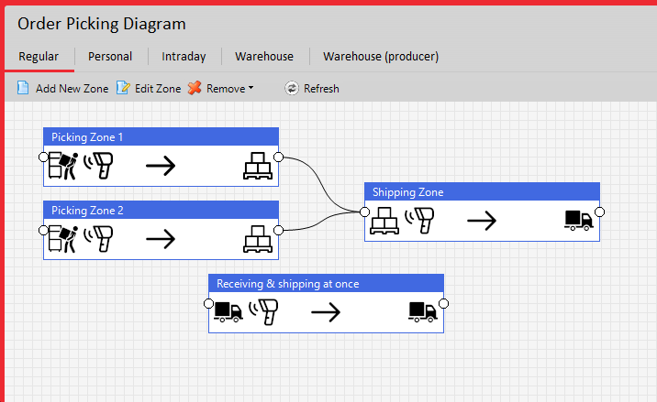
Picking & Packing
From simple Discrete order picking to complex Batch-Wave-Zone picking
Defining your own way to pick the goods by designing a picking diagram
Packing the goods while picking and/or re-packing later
Loading goods into truck by route generated by Nextis Logistics

Slide 6
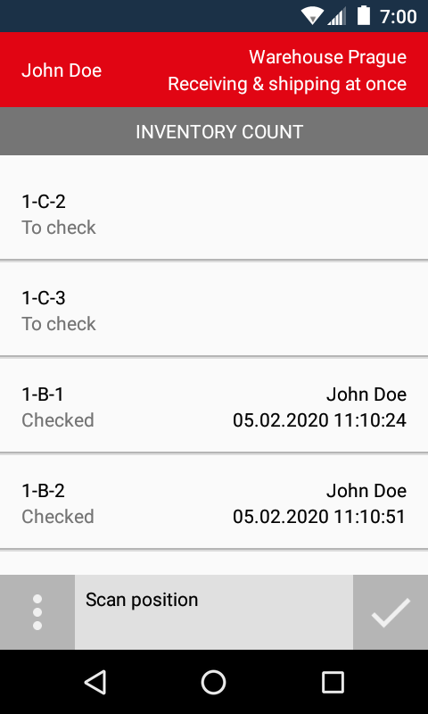
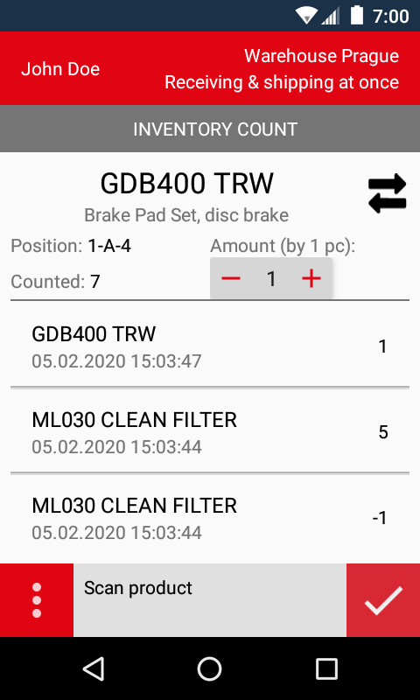
Inventory Counting
Full Inventory Counting & Cycle Counting
Two-phase Counting
  I. Counting All Items at Positions
  II. Re-Counting Only Selected Items

Slide 7
Hardware
Supported devices
Application Nextis Mobile WMS is currently developed for Zebra TC25 device, but it can be fully used on any other Zebra device with the same SDK.
The application can be run on any device with an Android (version 5.0 or higher), camera is used for scanning barcodes in that case.
It is possible to support other devices if needed.

